Slide 1

VE496 Advanced Technical Communication
Week 2:
Product Requirements and Technical Specifications
Nathaniel T. Murray 莫子禅
Summer 2020

Slide 2
What are Specifications?
Required outcomes or attributes of a product or service
Standards for performance, quality, and safety in a technical project
Methods, materials, and equipment to be used in a technical project

Slide 3
Types of Specifications
Functional (open): Focus on performance: what the device or system should be able to do, without necessarily specifying how to do it, so that different people could come up with different ways to achieve the same outcome
Technical (closed): Focus on components: exact size, shape, material, and other properties so that different people reading the same document should be able to produce the exact same thing

Slide 4
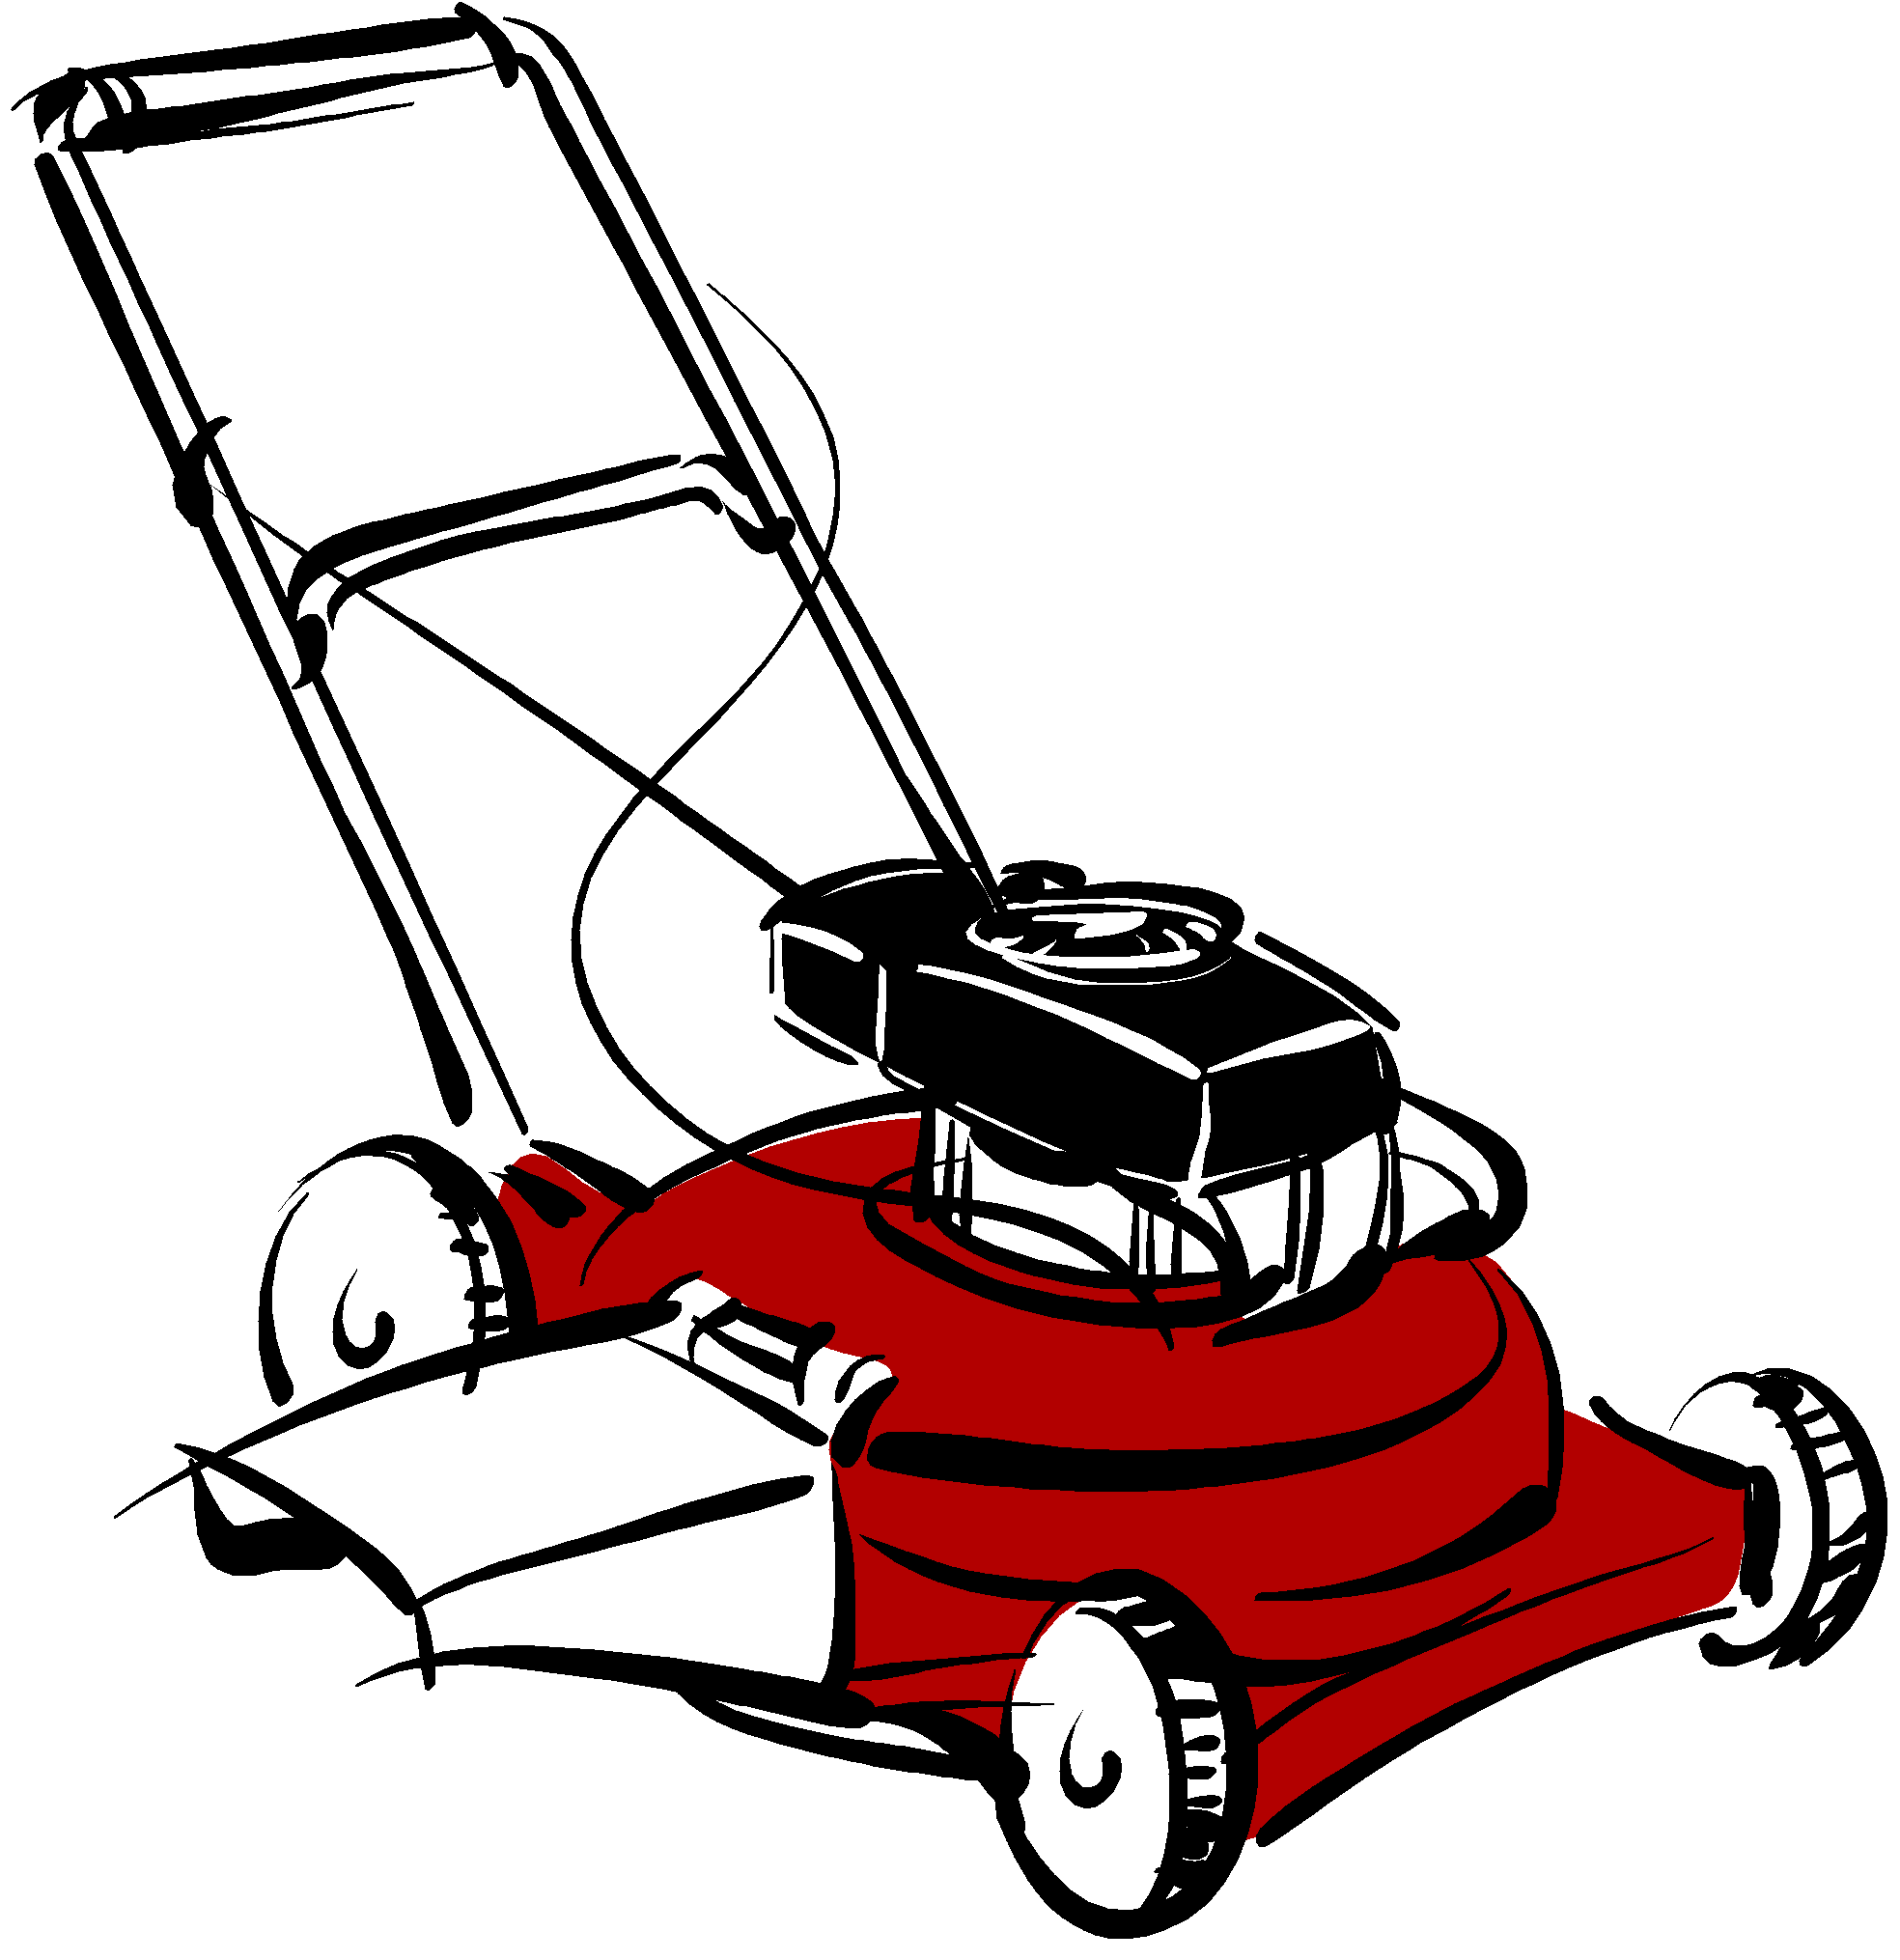
Functional Specifications: Example
Consumer Product Safety Commission: A lawn mower must have
Blade guard to prevent foot injury
Grass thrower that aims downward to prevent facial injury
“Kill switch” on the handle to instantly turn off device if necessary
Source: Lannon and Gurak (2018)

Slide 5
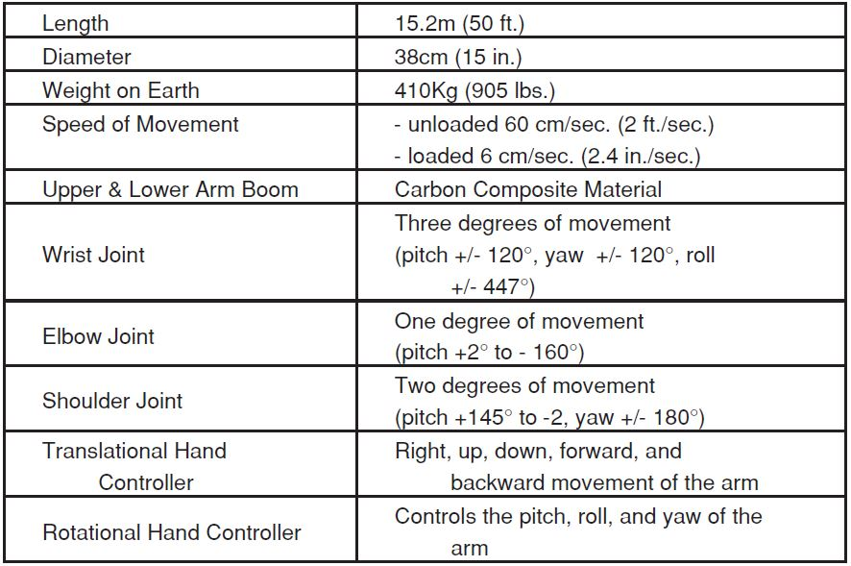
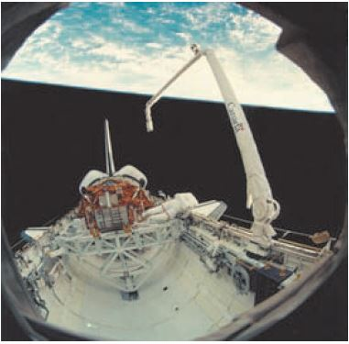
Technical Specifications: Example
Space Shuttle Remote Manipulator System (SRMS)
Source: Johnson-Sheehan (2015)

Slide 6
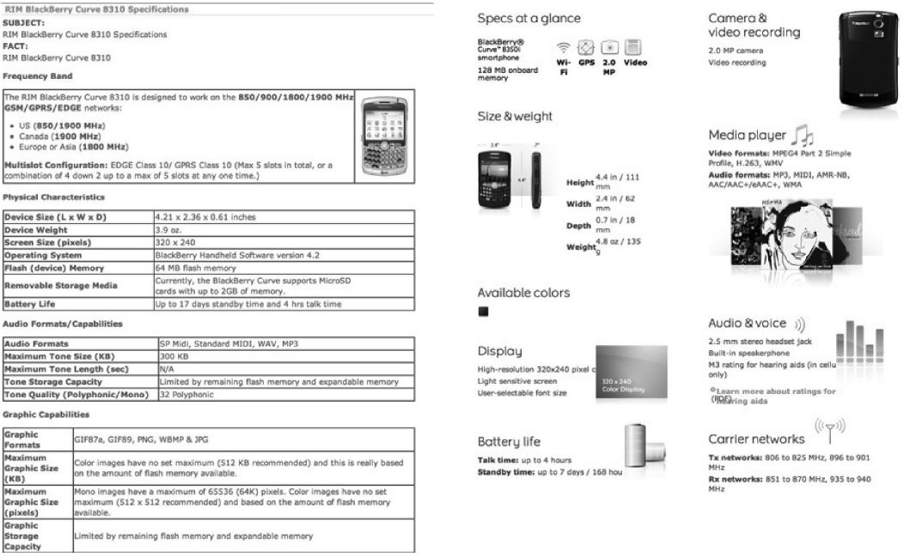
Source: Ewald (2017)

Slide 7
Technical Specifications
Sectors
Government: federal aviation, local city fire codes
Industry: software, logistics, automobile
Documents
Instruction manual
Specification document
Request for proposals (RFP)

Slide 8
Requirements and Specifications
Customer
Requirements
Technical
Specifications
Qualitative
Quantitative

Slide 9
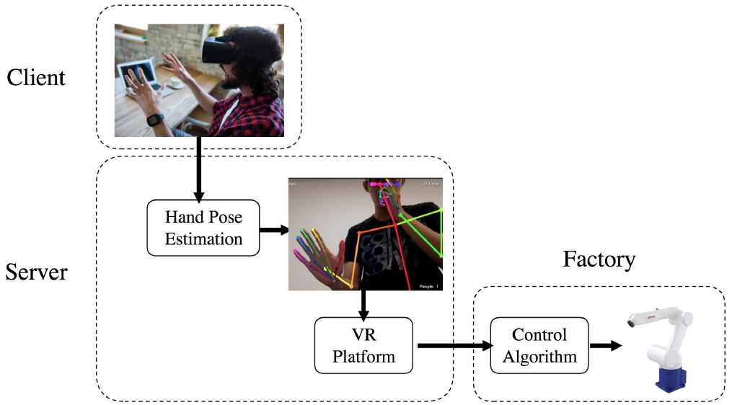
Example #1: Augmented Reality Robotic Arm
Requirements |  | Specifications
Robotic arm should mimic hand gestures as closely as possible
→
Pose estimation accuracy = 62 mAP (mean average precision)
Robotic arm should respond to hand gesture quickly
→
Time between VR command and hand pose estimation < 5 ms

Slide 10
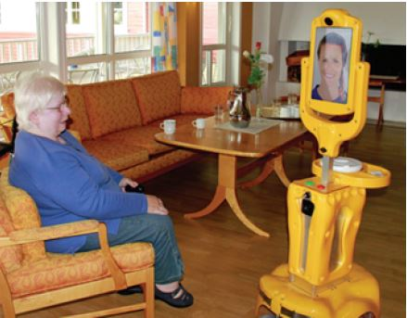
Example #2: Telepresence Robot
Requirements |  | Specifications
Medicine dispenser should have large storage box
→
Medicine storage volume = 100 mL
Screen should be clear enough for elderly to see
→
Screen resolution = 1280 x 720 pixels

Slide 11
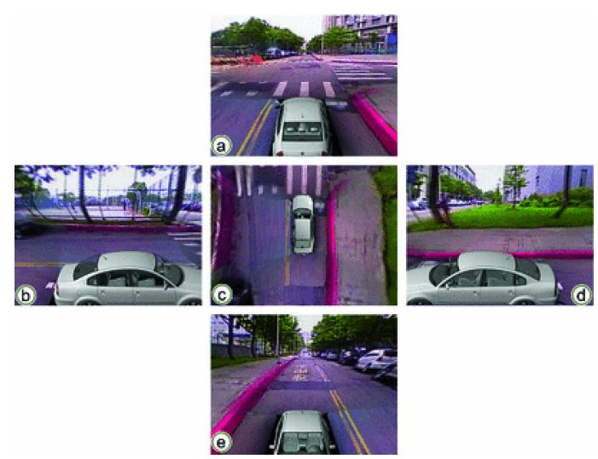
Example #3: Multi-Camera Video Stitching
Requirements |  | Specifications
Images should look “normal” and similar to each other
→
SSIM (structural similarity index) close to 1
Processed video should look like it is streaming live
→
Processing time per frame = 40-50 ms

Slide 12
Specifications: Writing Guidelines
Technical specification should be a concrete variable or unit of measurement
Time, volume, degree of rotation, category (e.g. programming language)
Remember the unit of measurement after the value: 450 [450 what?]
Use the imperative (must, shall) instead of the conditional (if possible)
Use positive language (should) instead of negative language (should not)
Consider your audience: customers, engineers, designers, contractors, manufacturers, suppliers, subcontractors, government inspectors
Use consistent terminology: same term for the same idea
Write the unit of measurement correctly: mPA → mAP

Slide 13
Close Reading Practice
The first step of the proposed method is to assign expected symmetric distributions to the design variables, as well as to fit the experimental response and the computer simulation response with a distribution. This step has already been performed and are presented earlier. Note that the experimental observations are fitted with an Inverse Gaussian distribution rather than a Normal distribution. The variability of these distributions is not an issue and as such they have been used in the second step to draw 250 random samples from the experimental distribution. Subsequently, Eq. (12) has been applied to generate their corresponding computer simulation samples. These samples have been used in the third step of the proposed procedure to estimate the MLIPs (most likely input parameters) and TIPs (theoretical input parameters) through Eqs. (16) and (17), respectively. More specifically, the corresponding optimization problem has been solved using a pattern search algorithm.
Source: Beek et al. (2018)

